Slide 1
AVL Search Trees
Materials are adapted from “Data Structures: A Pseudocode Approach with C,” 2nd ed., by Richard F. Gilberg & Behrouz A. Forouzan

Slide 2
AVL Tree Basic Concepts
Binary search tree
is simple and easy to understand
One major problem: it is not balanced
An AVL tree
is a BST that is guaranteed to always be balanced
Is a BST in which the heights of the subtrees differ by no more than 1

Slide 3
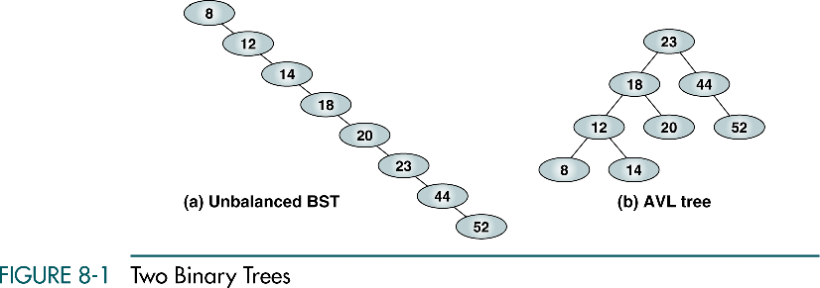
The equivalent of a linear list
To locate 12, 2 tests
To locate 14, 3 tests
To locate 52, 8 tests
Search effort is O(n)
To locate 12, 3 tests
To locate 14, 4 tests
The maximum search effort for this tree is either 3 or 4.
Search effort is O(logn)

Slide 4

AVL Tree Basic Concepts
Balancing a tree can lead to significant performance improvements
AVL tree
Is a binary tree that either is empty or consists of two AVL subtrees, T_{L}, and T_{R}, whose heights differ by no more than 1
A.k.a height-balanced tree
$$\left|H_{L}−H_{R}\right|≤1$$

Slide 5
AVL Tree Balance Factor
The balance factor for any node in an AVL tree must be +1, 0, or -1
LH for left high (+1) : left subtree is higher than the right subtree
EH for even high (0) : the subtrees are the same height
RH for right high (-1) : left subtree is shorter than the right subtree

Slide 6
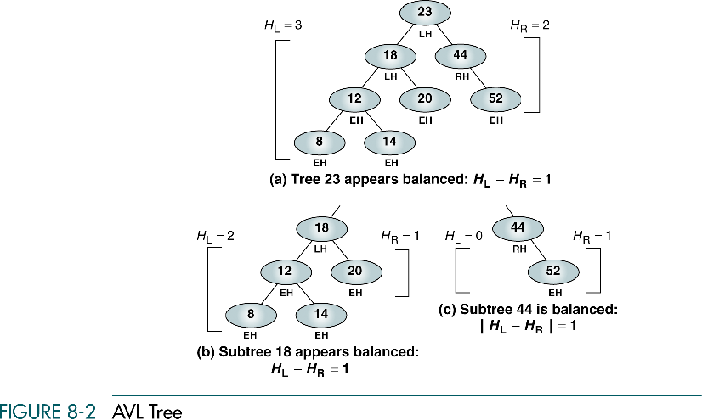

Slide 7
Balancing Trees
Whenever we insert a node into a tree or delete a node from a tree, the resulting tree may be unbalanced
When we detect that a tree has become unbalanced, we must rebalance it
AVL trees are balanced by rotating nodes either to the left or to the right

Slide 8
Balancing Trees
Four cases that require rebalancing
Left of left
A subtree of a tree that is left high has also become left high
Right of right
A subtree of a tree that is right high has also become right high
Right of left
A subtree of a tree that is left high has become right high
Left of right
A subtree of a tree that is right high has become left high

Slide 9
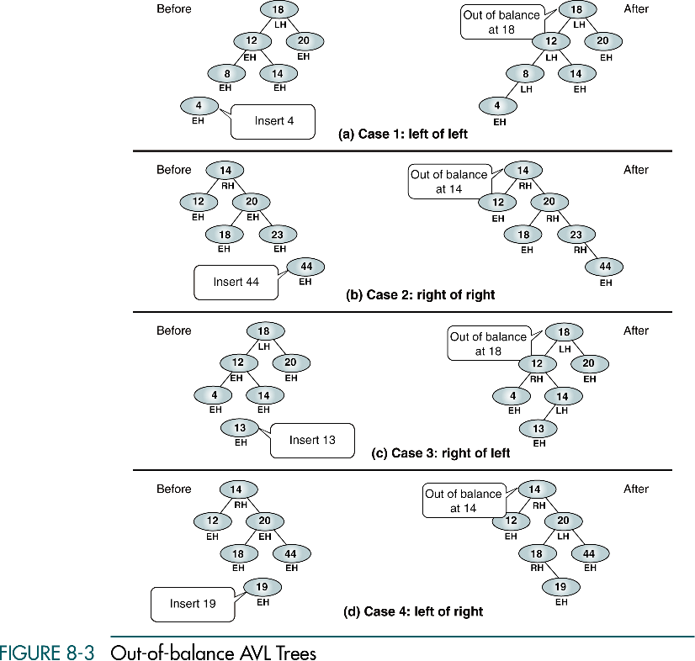

Slide 10
(continued)

Slide 11
Case 1: Left of left
When the out-of-balance condition has been created by a left high subtree of a left high tree
We must balance the tree by rotating the out-of-balance node to the right
Single rotation

Slide 12
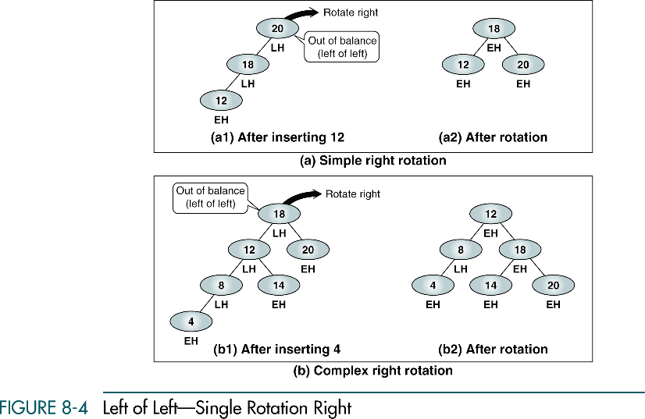

Slide 13
Case 2: Right of right
When the out-of-balance condition has been created by a right high subtree of a right high tree
We must balance the tree by rotating the out-of-balance node to the left
Single rotation

Slide 14
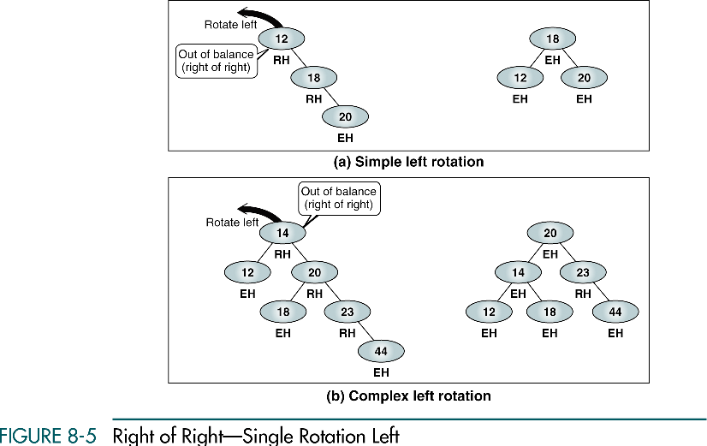

Slide 15
Case 3: Right of left
When the out-of-balance condition has been created by a right high subtree of a left high tree
We must balance the tree by rotating the left subtree to the left, then rotating the out-of-balance node to the right
Double rotation

Slide 16
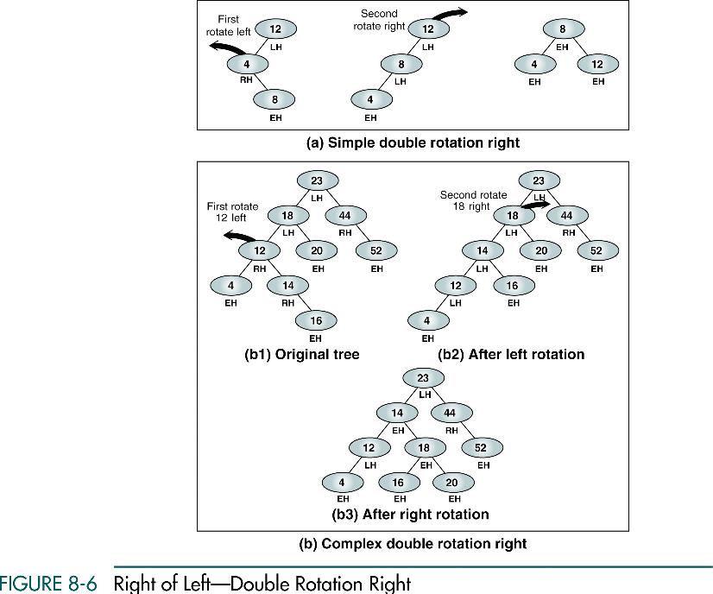

Slide 17
Case 4: Left of right
When the out-of-balance condition has been created by a left high subtree of a right high tree
We must balance the tree by rotating the right subtree to the right, then rotating the out-of-balance node to the left
Double rotation

Slide 18
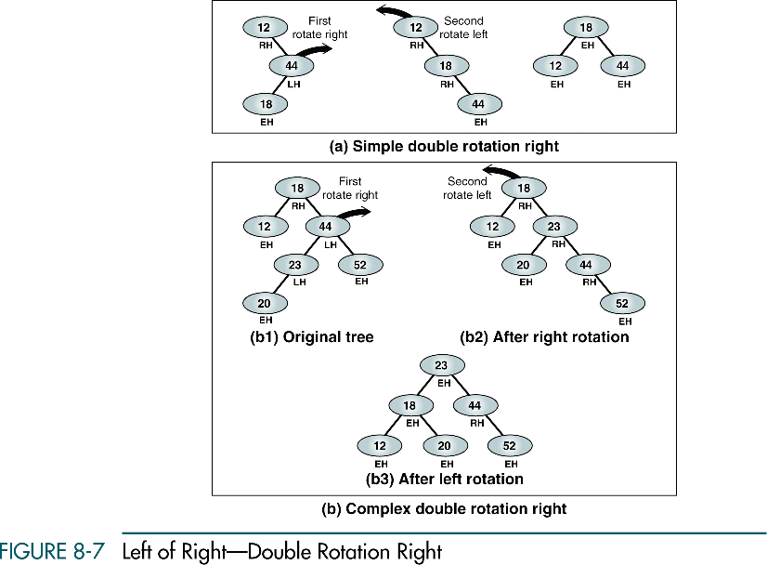

Slide 19
AVL Tree Implementations
The search and retrieval algorithms are the same as for any binary tree
Insertion and deletion in an AVL tree follow the same basic rules for insertion and deletion in a BST
The difference lies in the tree balancing, which occurs as we back out of the tree

Slide 20
Insert into AVL Tree
All inserts take place at a leaf node
To find the appropriate leaf node, we follow the path from the root, going left when the new data’s key is less than a node’s key and right otherwise
Once we have found a leaf, we connect it to its parent node and begin to back out of the tree
As we back out of the tree, we constantly check the balance of each node
When we find that a node is out of balance, we balance it and the continue up the tree

Slide 21
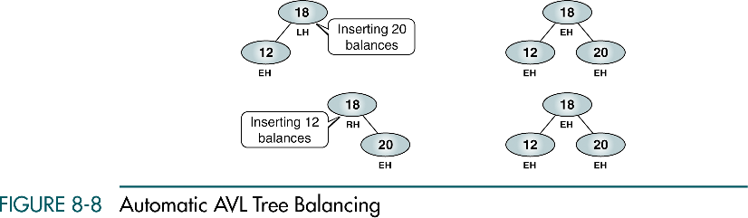
Insert into AVL Tree
Not all inserts create an out-of-balance condition
When we add a node on the right branch of a left high node, automatic balancing occurs and the node is now even high

Slide 22
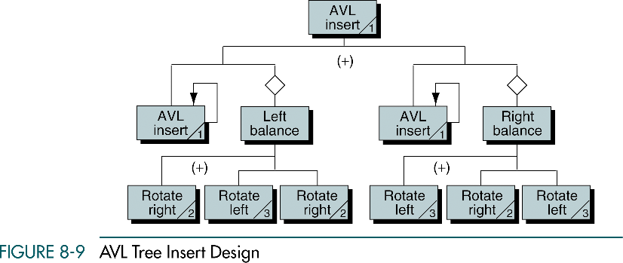
Inserting on a left branch

Slide 23
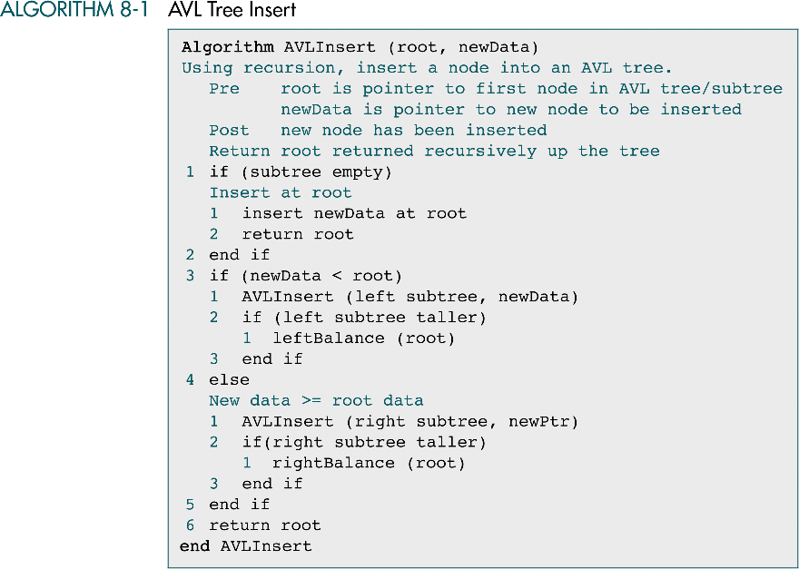

Slide 24
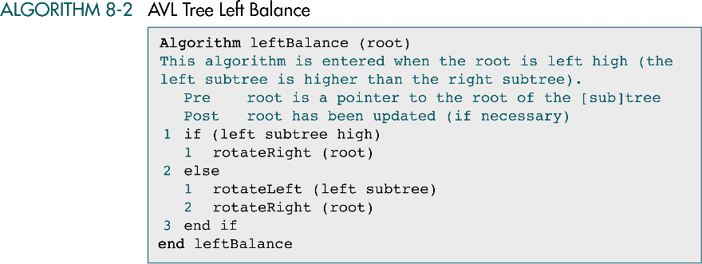
AVL Tree Left Balance Algorithm

Slide 25
Rotate Algorithms
To rotate a node, we simply exchange the root and the appropriate subtree pointers

Slide 26
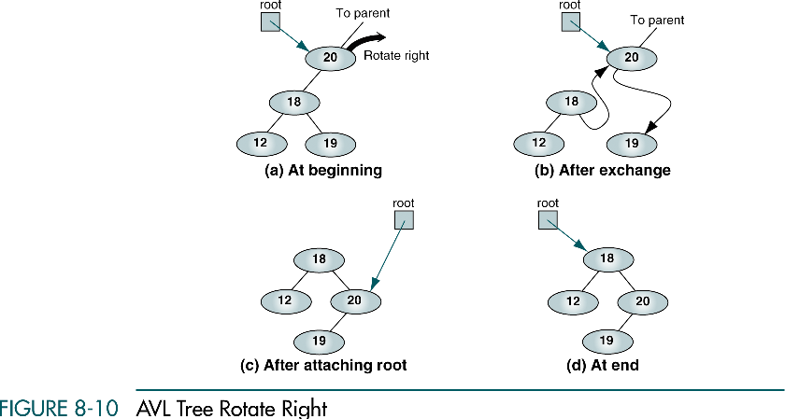

Slide 27
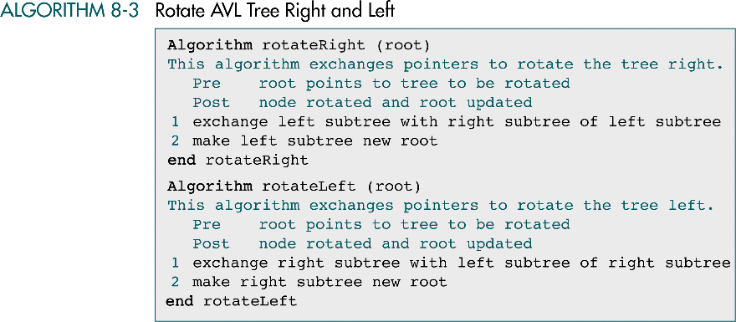

Slide 28
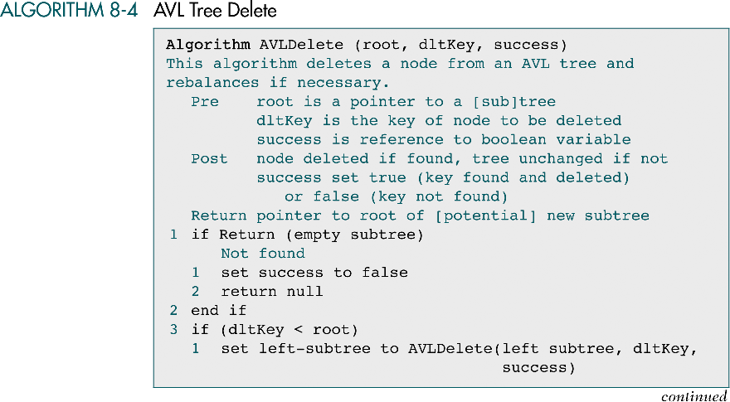

Slide 29
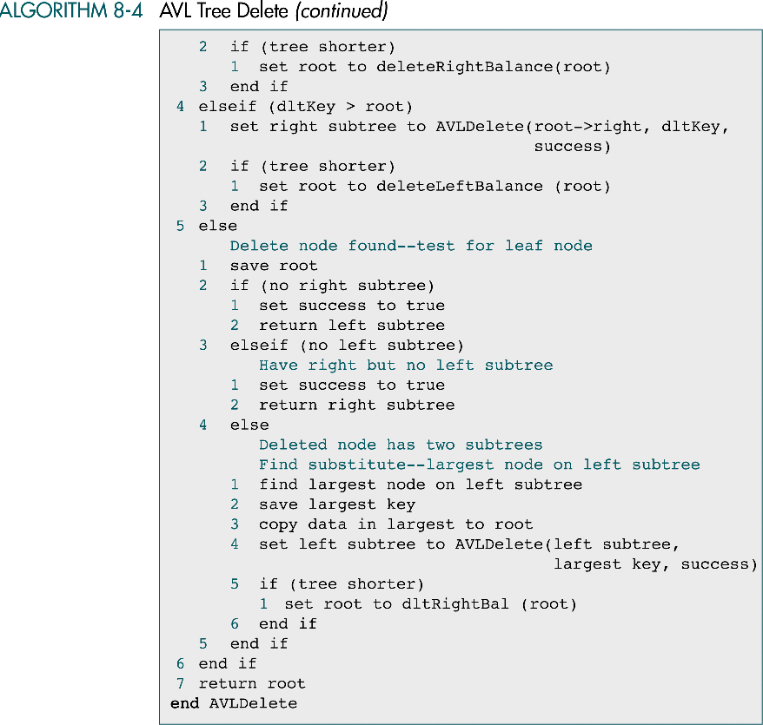

Slide 31
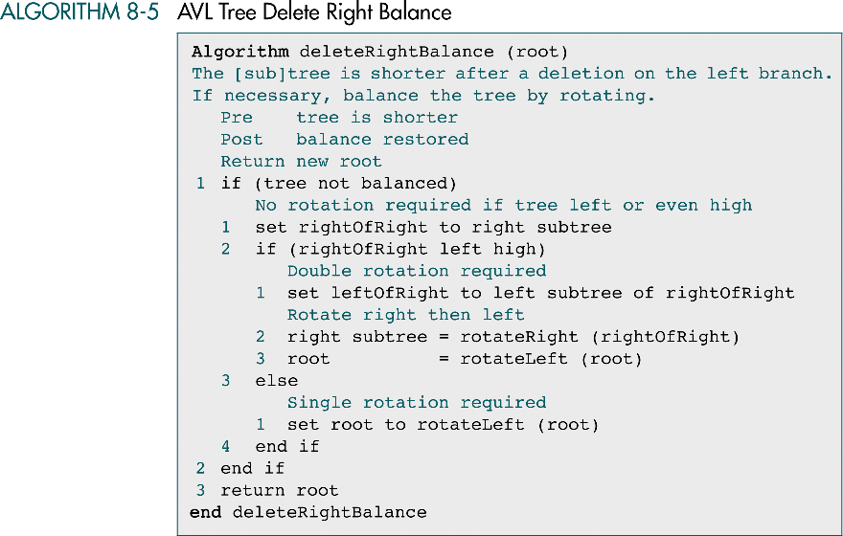

Slide 32
